Slide 1
NeRF Benchmark

Slide 2
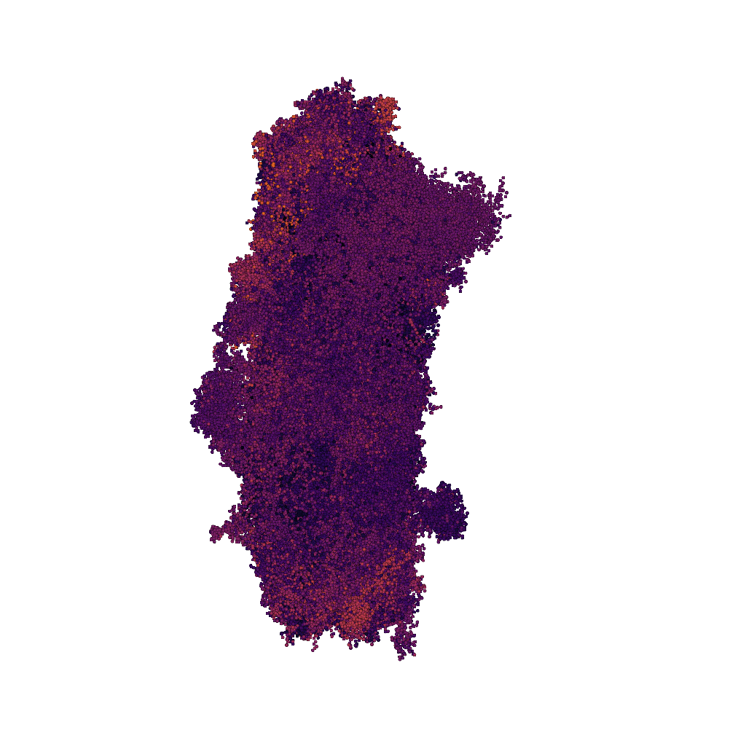
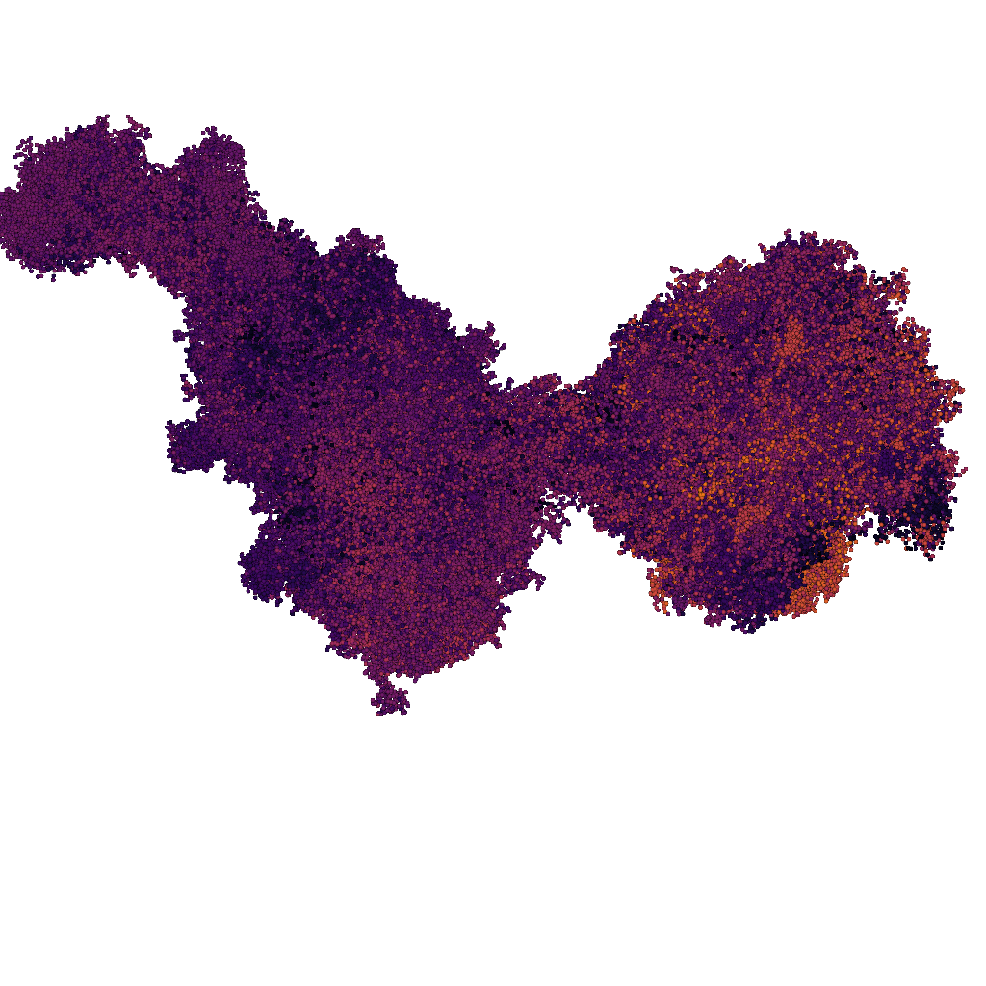
Training Data & Device
Visualization of one halo rendered as point cloud
Image size: 1024 x 1024
GPU: NVIDIA RTX A6000 (49GB)
Training examples with two camera angles

Slide 3
NeRF Model Configuration
Basic: (~ 6GB memory to train)
train_num_rays_per_batch = 4096
Hidden dim = 64
Max resolution: 2048
Large: (~ 12GB memory to train)
train_num_rays_per_batch = 8192
Hidden dim = 128
Max resolution: 4096

Slide 4
Experiment with Number of Training Images Using Basic NeRF Configuration
# Images | Training Data Size | Model Size | PSNR | PSNR_STD | SSIM | SSIM_STD | LPIPS
50 | 40 MB | 168 MB | 22.99 | 1.354 | 0.73 | 0.053 | 0.192
100 | 80 MB | 168 MB | 22.93 | 1.078 | 0.74 | 0.046 | 0.198
150 | 121 MB | 168 MB | 23.36 | 0.850 | 0.75 | 0.026 | 0.193
200 | 161 MB | 168 MB | 23.44 | 0.706 | 0.75 | 0.027 | 0.20
Training time: 12 mins to 15 mins
Inference fps: 0.3 to 0.4

Slide 5
Summary
Require 150 to 200 images to train
Big model generates clearer results visually
But psnr and ssim value is lower (psnr and ssim are most common used measurement, but not the most accurate)
lpips (Learned perceptual image patch similarity): [0, 1] The higher value, the more different the patches are. Big model has smaller lpips value (0.13 vs 0.2)
Training for the big model costs several hours
The FPS is not high, less than 1 fps, not interactive when processing.

Slide 6
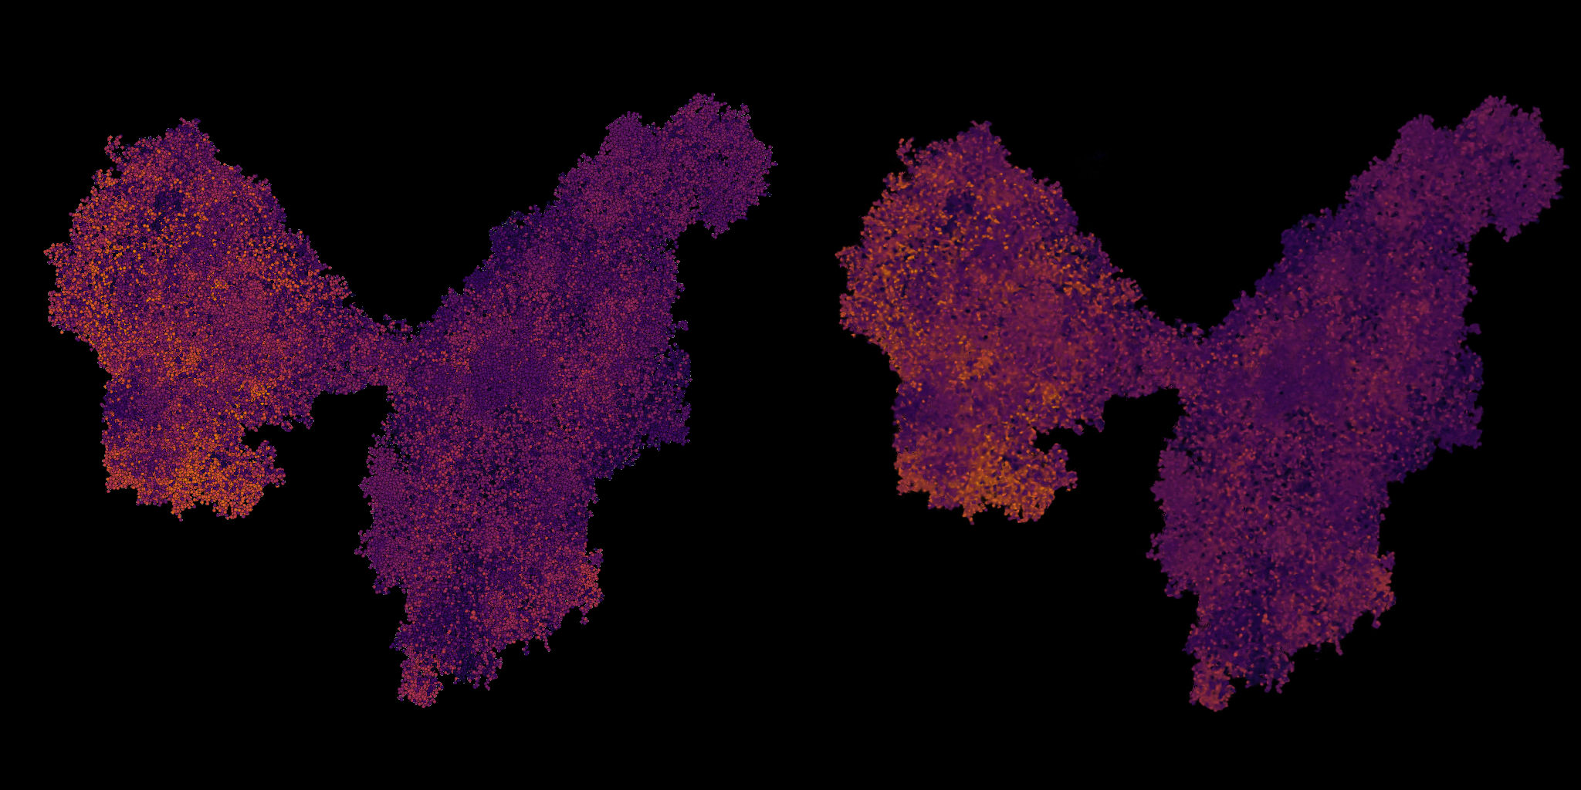
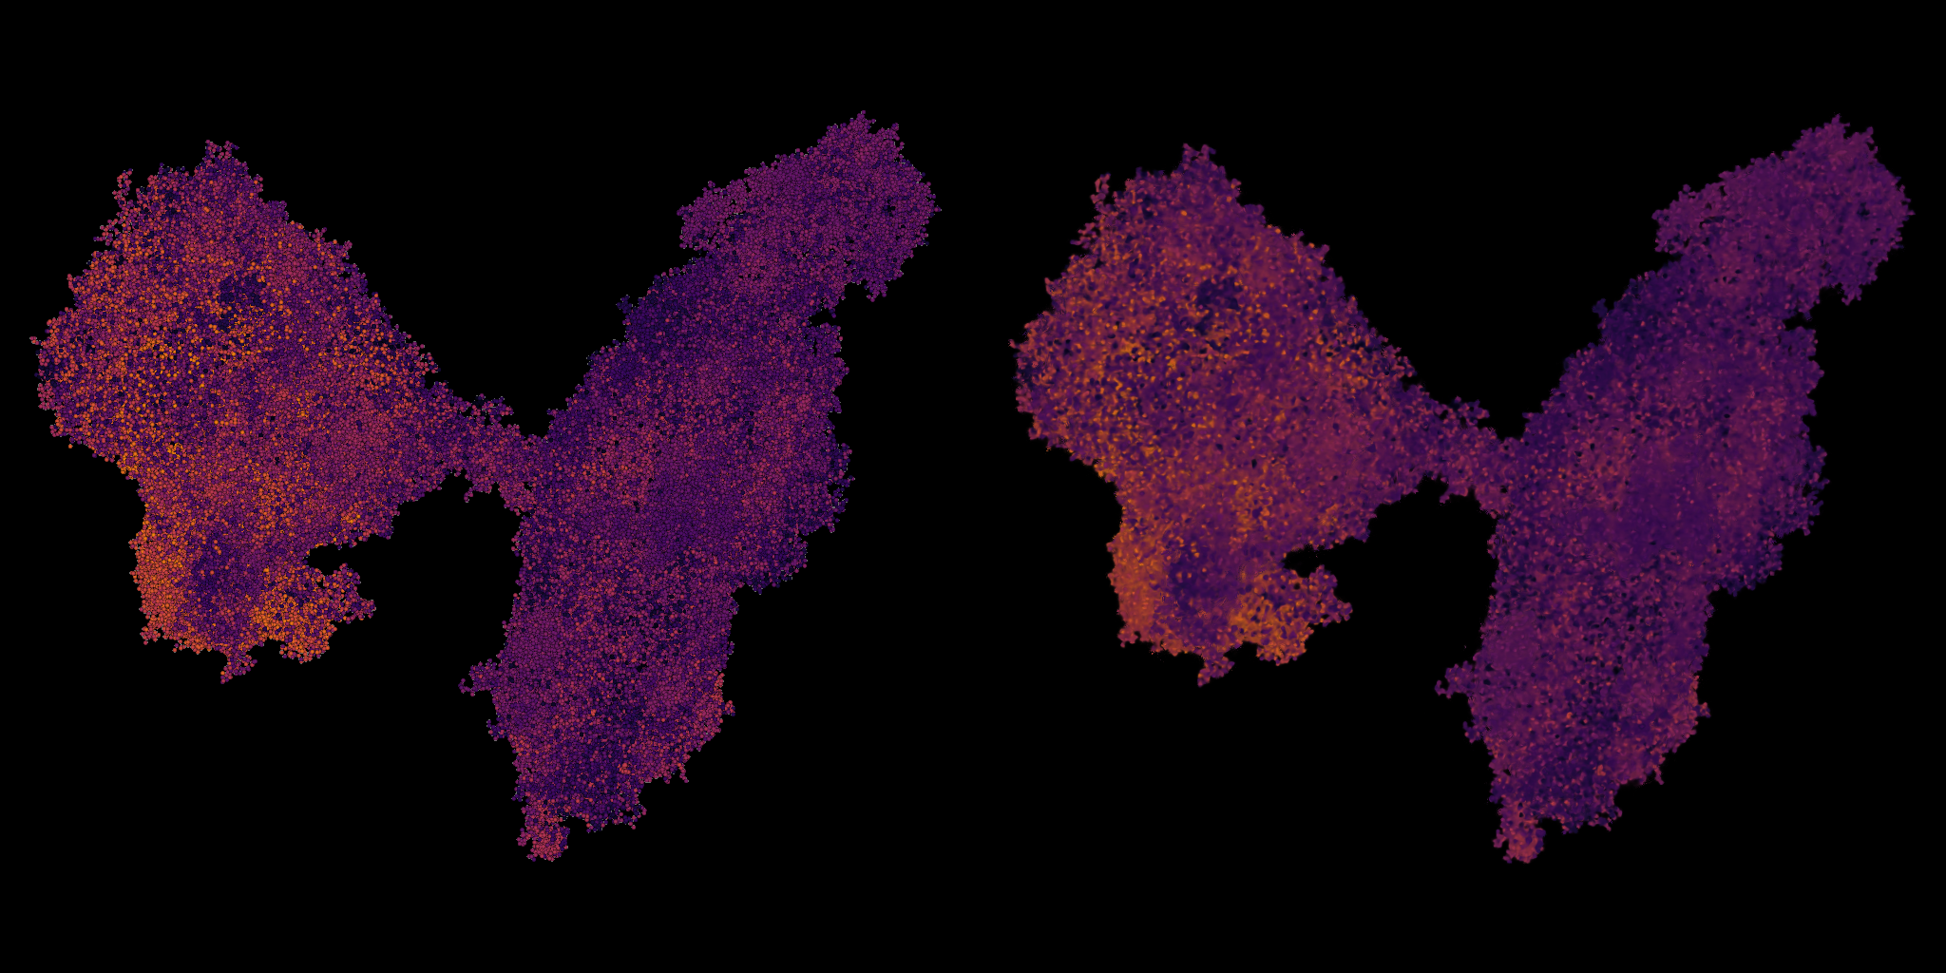


Trained with 50 images
Trained with 100 images

Slide 7
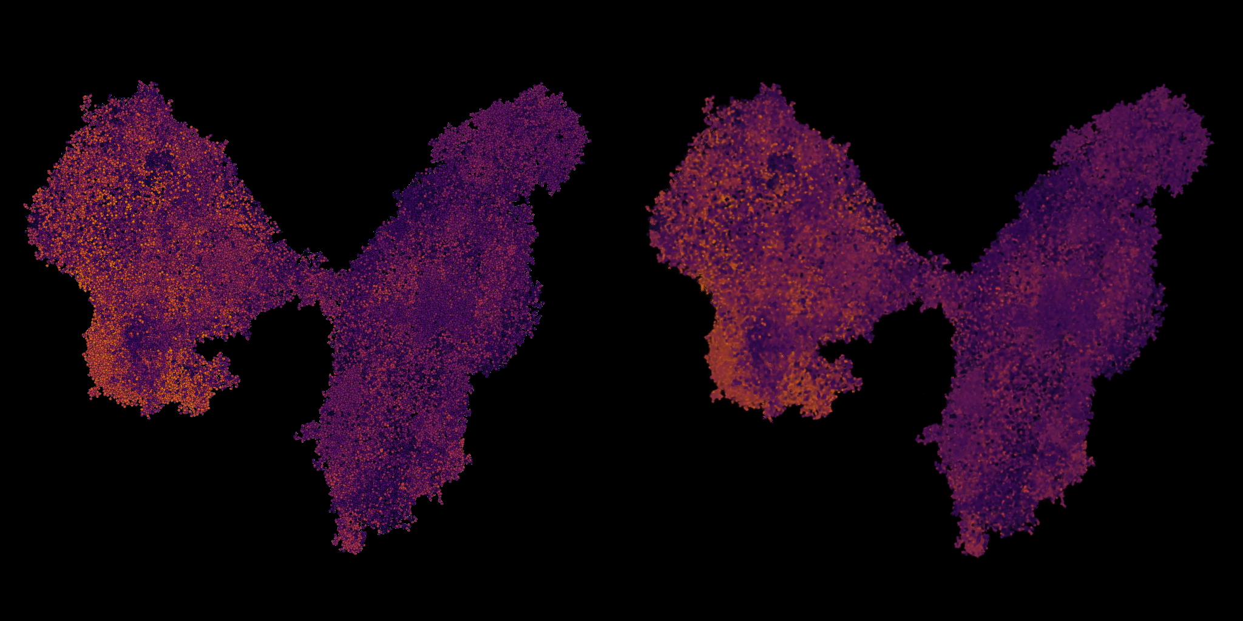
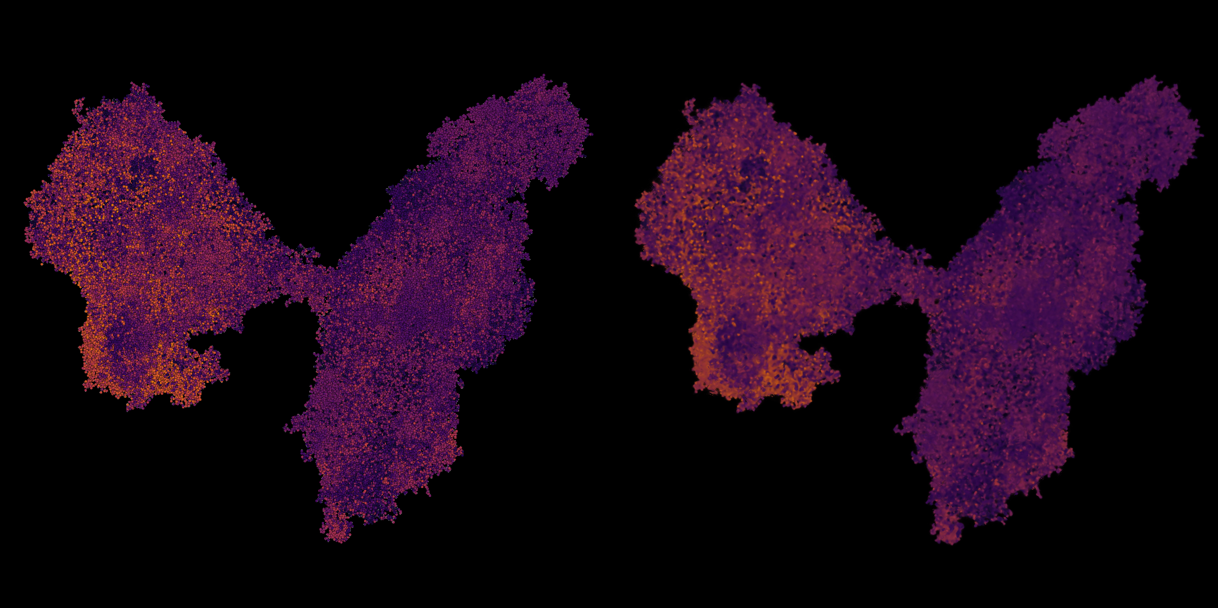


Trained with 150 images
Trained with 200 images

Slide 8
Include Depth Map in Training
# Images | Training Data Size | Model Size | PSNR | PSNR_STD | SSIM | SSIM_STD | LPIPS
w/o depth | 161 MB | 168 MB | 23.44 | 0.706 | 0.75 | 0.027 | 0.20
w/ depth | 187 MB | 176 MB | 25.78 | 0.682 | 0.81 | 0.016 | 0.18

Slide 9
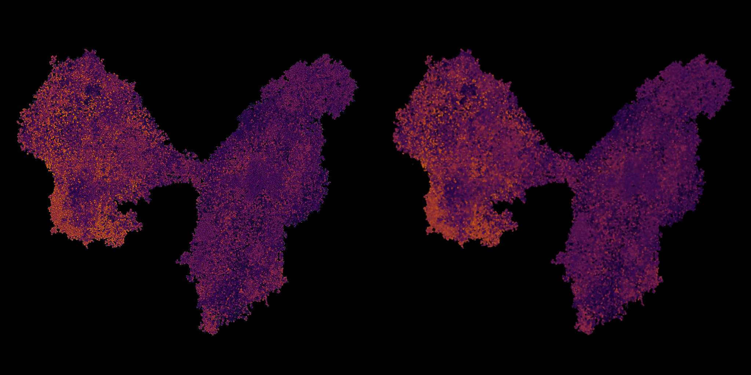
W/O Depth
W/ Depth

Slide 10
Basic v.s. Big Model
 | Training Data Size | Model Size | PSNR | PSNR_STD | SSIM | SSIM_STD | LPIPS
Basic | 161 MB (#200) | 168 MB | 23.44 | 0.706 | 0.75 | 0.027 | 0.20
Big | 161 MB (#200) | 550 MB | 21.75 | 0.69 | 0.732 | 0.0286 | 0.13
Basic Model Training Time: 12 to 15 mins
Big Model Training Time : 4 to 6 hours

Slide 11
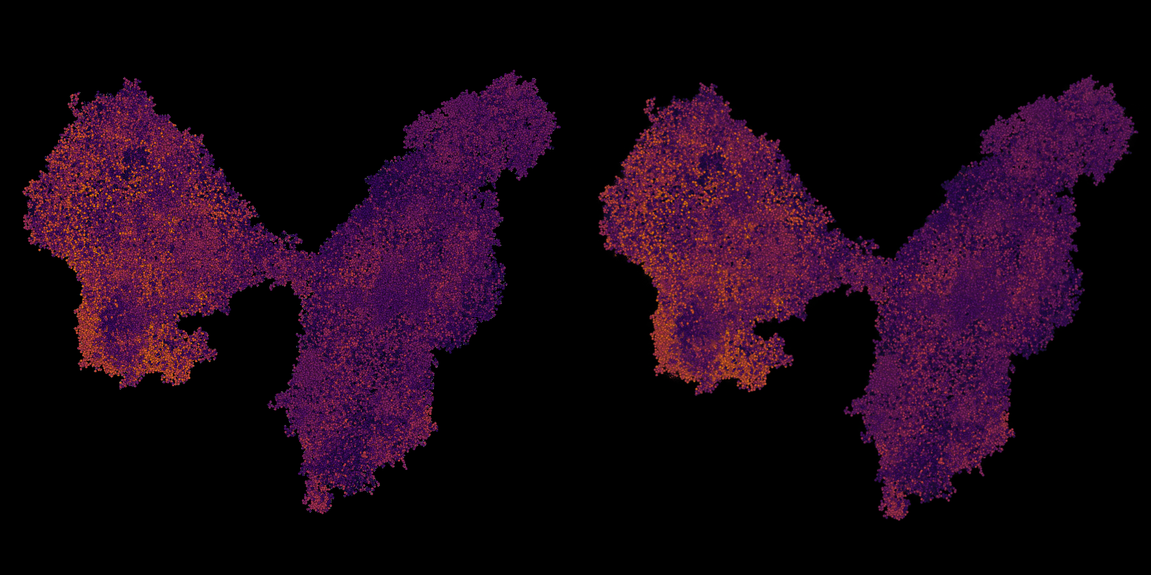
Ground truth
Basic
Big

